Slide 1

Weekly Report: Week 2
GSP Team B

Slide 2

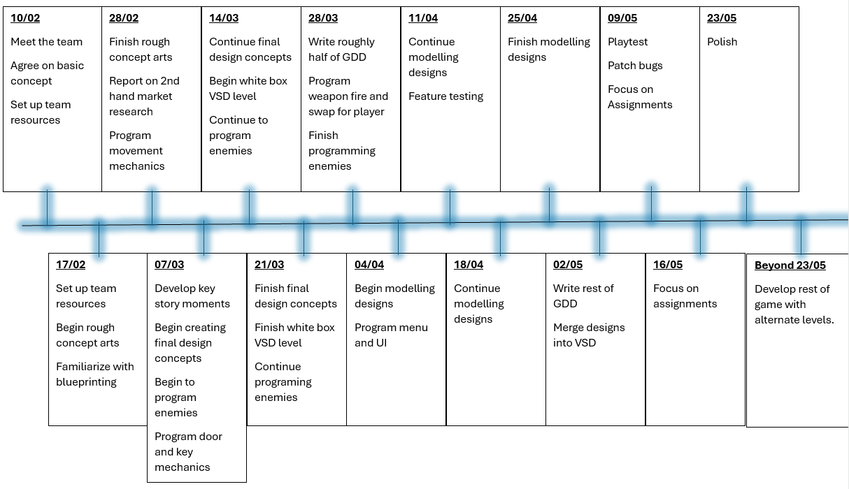
Progress

Slide 3
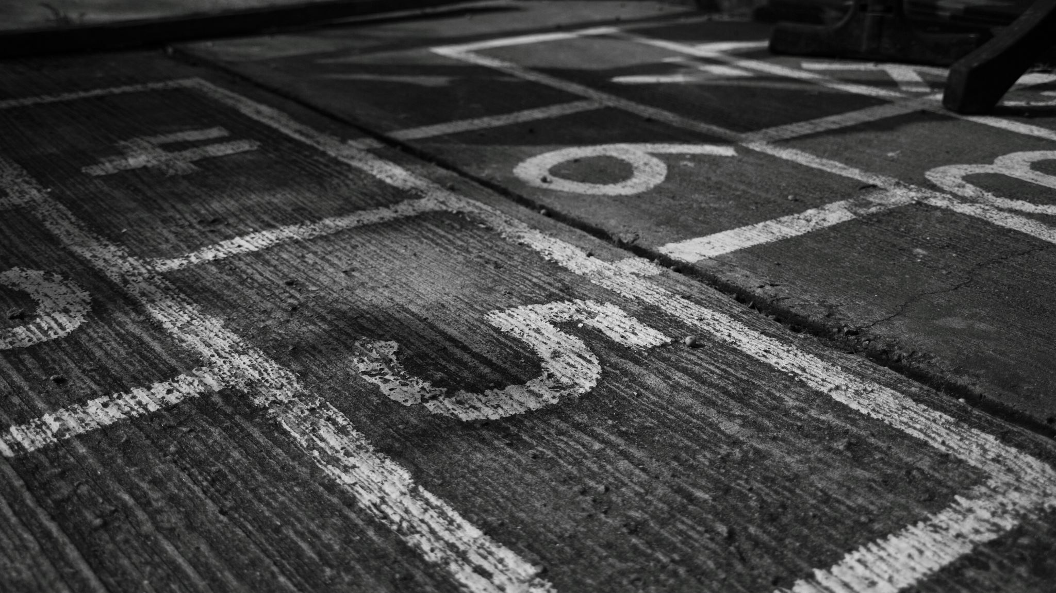
Key Milestones
21/03
Final concept arts done
21/03
Full white box level done
28/03
Large write up of GDD done
25/04
Finish modelling
02/05
Finish merging designs and mechanics
09/05
Playtest

Slide 4

Team Activity
Graphs and statistics on team activity and performance should go here

Slide 5

Summary
Any changes we have made in our plan since last time should be addressed here if they are relevant details.

Slide 6

Team Member Presentations
At this point each team member will present what they have been doing over the past week.

Slide 7
Toby
Organise discord
Adjusting project plan/timeline
Writing week 2 report

Slide 8
Samuel
Creating rough level concept designs with Blaine

Slide 9
Blaine
Creating rough level concept designs with Samuel

Slide 10
Bronwyn
Creating rough concept art for weapons

Slide 11
Bailey
Creating rough concept art for enemies

Slide 12
Josh
Helping to create rough enemy concepts

Slide 13
Owen
Researching and developing enemy AI

Slide 14
Dan
Researching and developing door and key mechanics

Slide 15
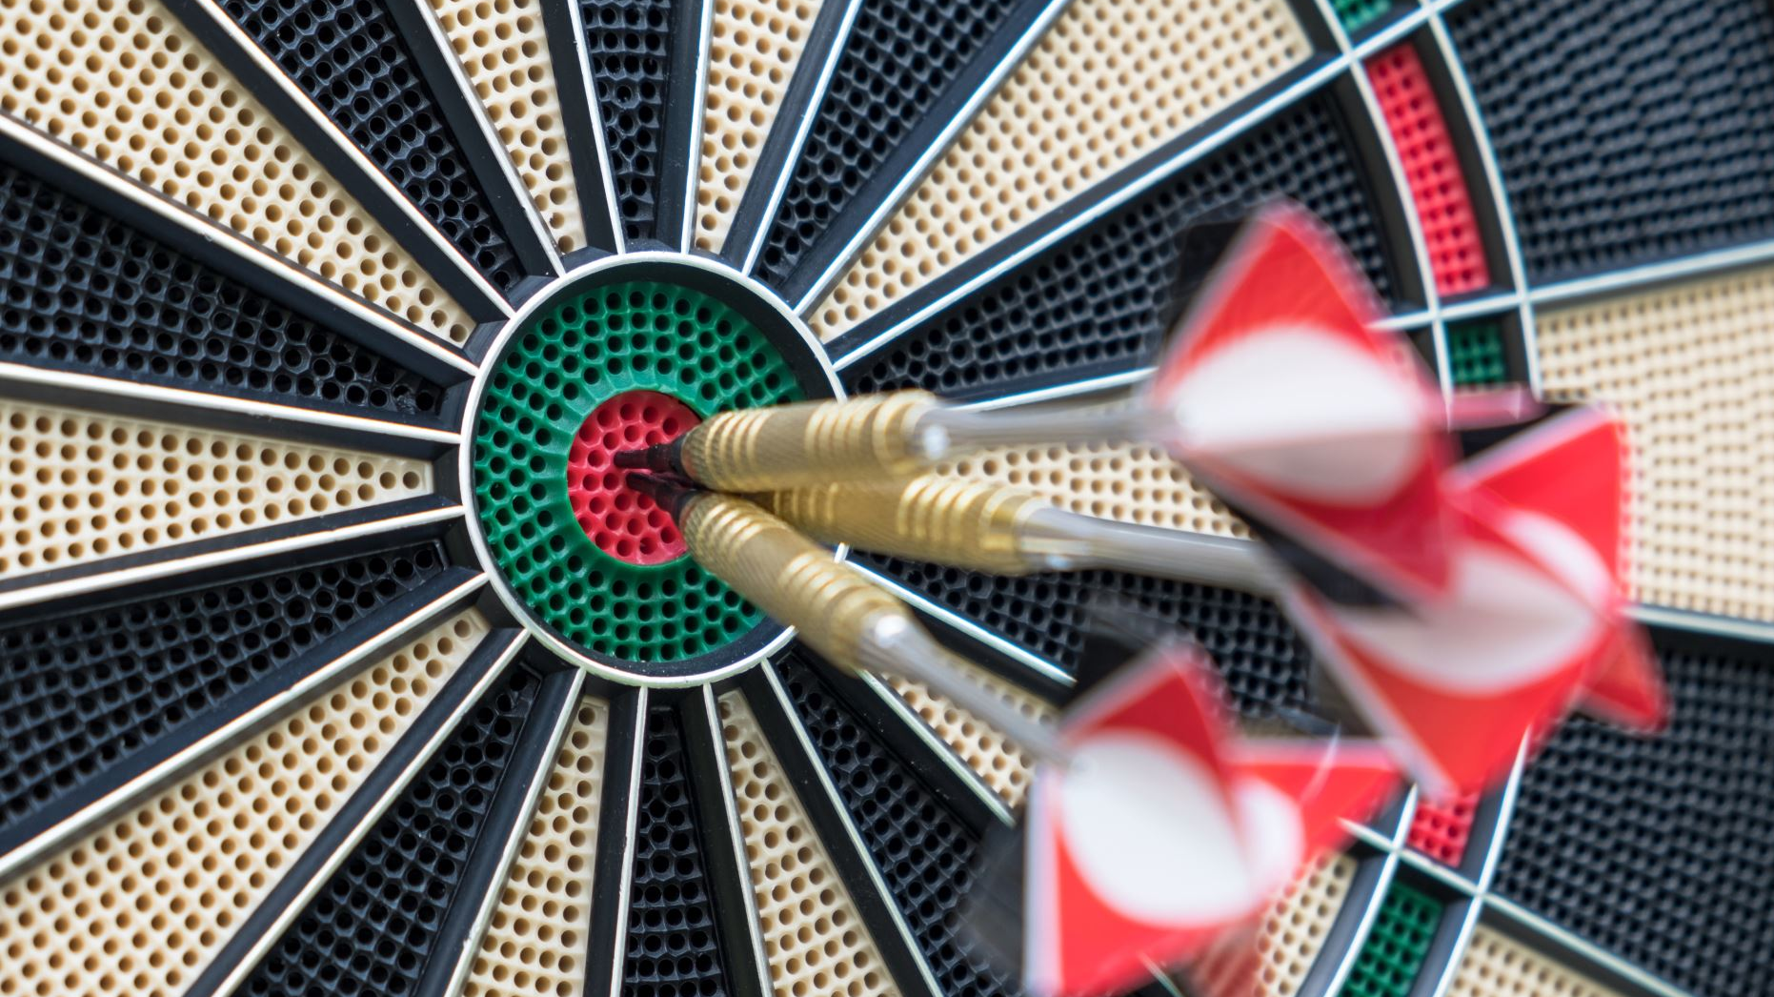
Next Weeks Targets
Toby- Find and analyse market studies.
Sam- Finish rough level concept.
Blaine- Finish rough level concept.
Josh- Help concept enemies.
Bronwyn- Finish rough weapon concepts.
Bailey- Continue concepting enemies.
Dan- Find and analyse market studies.
Owen- Find and analyse market studies.

Slide 16
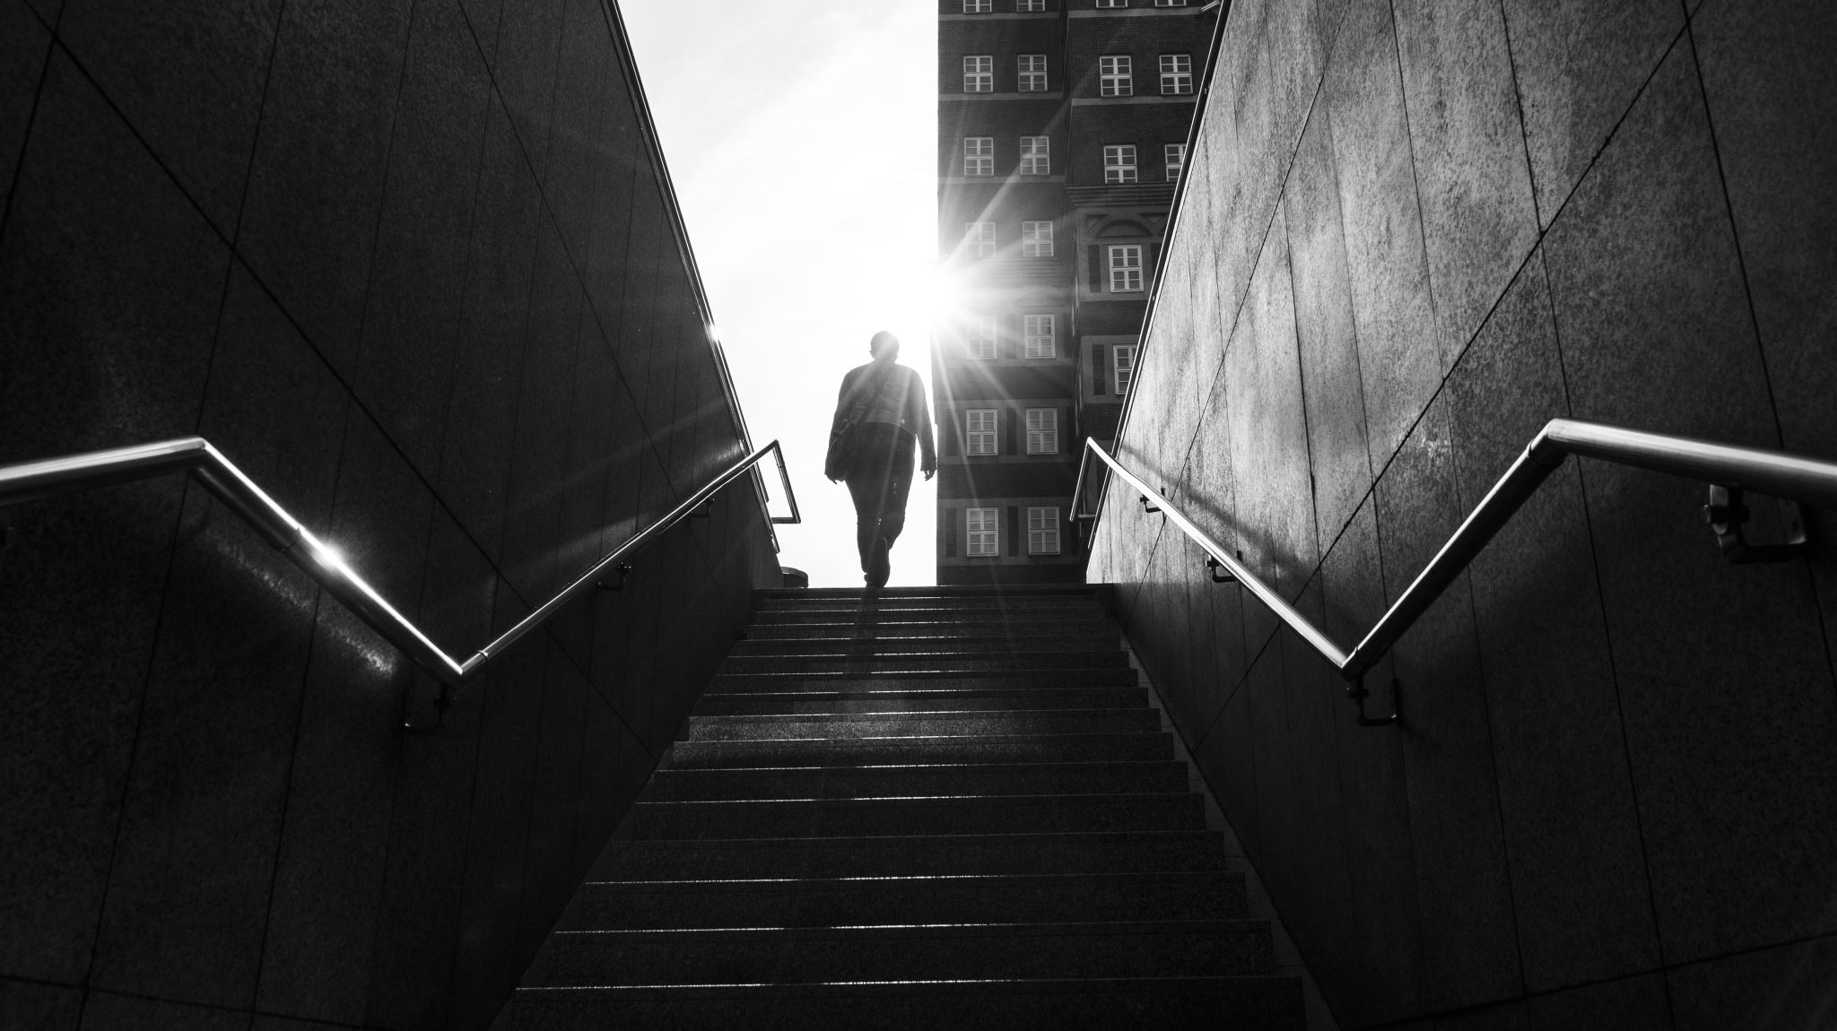
Challenges
Medical issues, illness, familiarity with github and blue printing, struggles communicating, disengagement, time management with other units.

Slide 17

Anything We Need Help With?
How do we fix conflict errors in github?
How do we push large files to github?

